Slide 1

TRAVEL G O
TEAM - KNOWSNOALGO

Slide 2
AGENDA
What is it…?
What does it do…?
Why to use TravelGo…?
Great features in our app
Demo – TravelGo android application
Upcoming Features
Mobile application development process
Time to call TravelGo
a

Slide 3

What is it…?
an android application
provide transportation as reliable as running water
everywhere for everyone
for office transports and school bus providers etc

Slide 4

What does it do…?
easiest and fastest route suggestions from pickup to drop location
helps to plan shortest routes with the purpose of minimizing overall costs

Slide 5
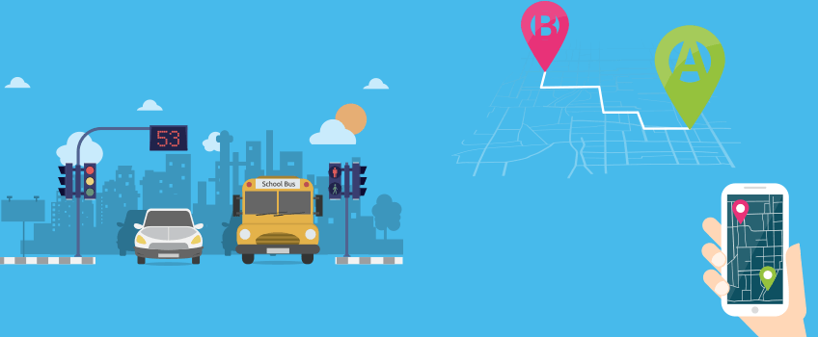
Why to use TravelGo…?
user friendly and easy to use
g
provides an amazing user exp.
a
allows booking in no time

Slide 6

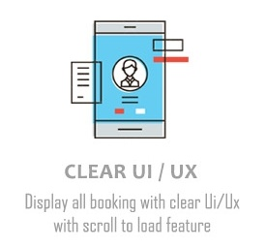



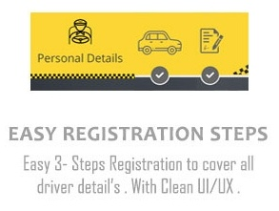
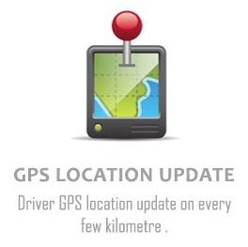
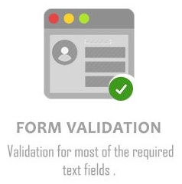
Great Features In Our App

Slide 7
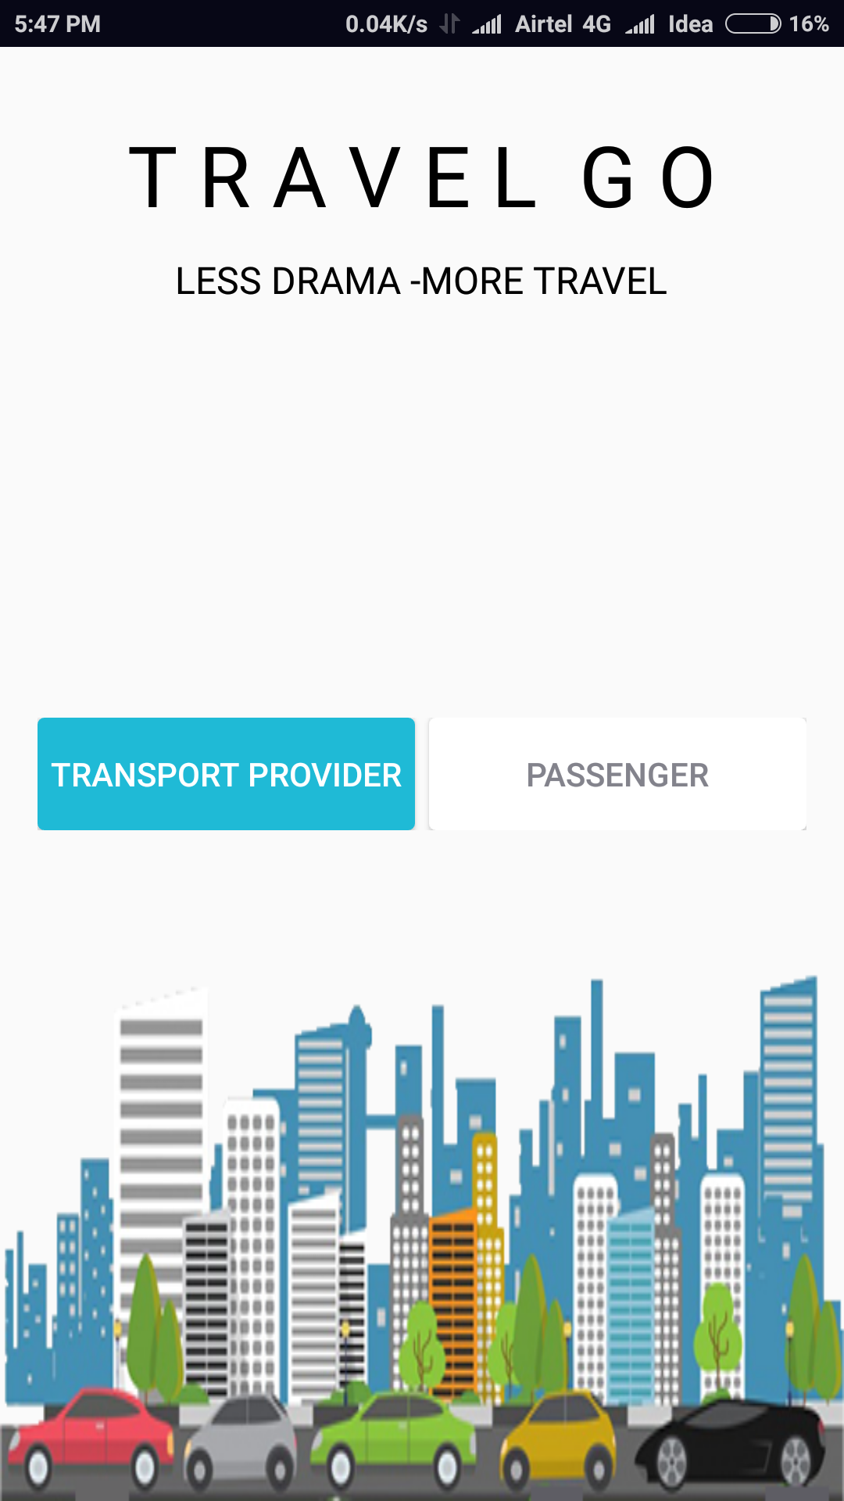
DEMO – TravelGo Android Application
Transporter module
Passenger module

Slide 8
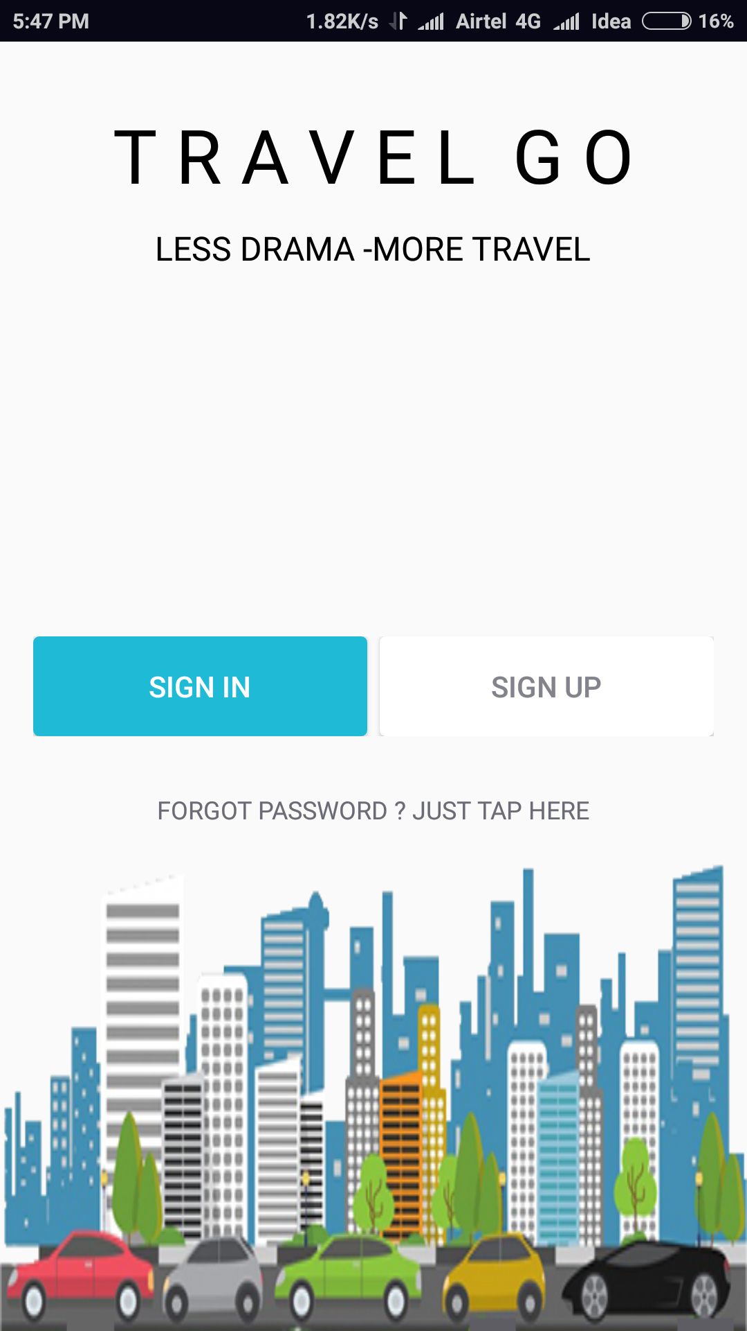
Sign in Button
Forgot Password
Sign up Button

Slide 9
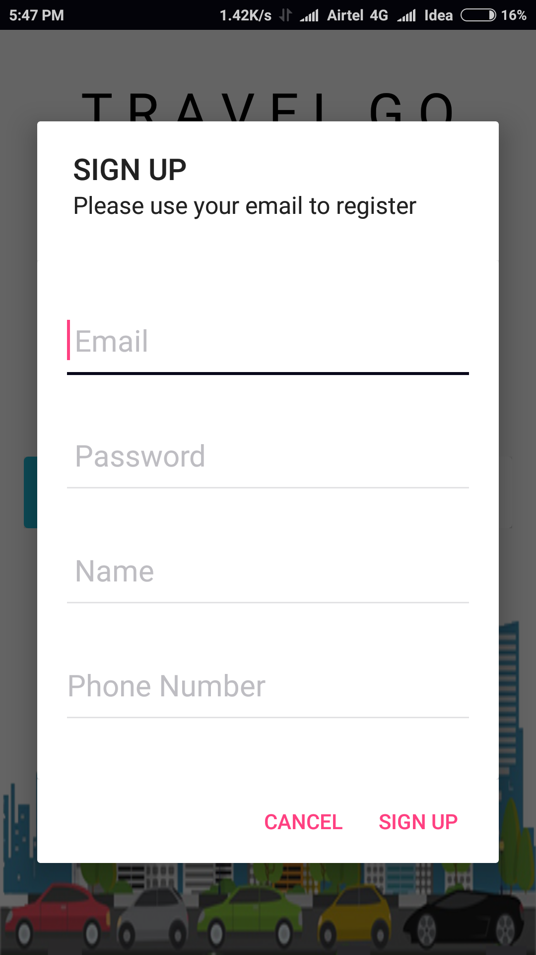
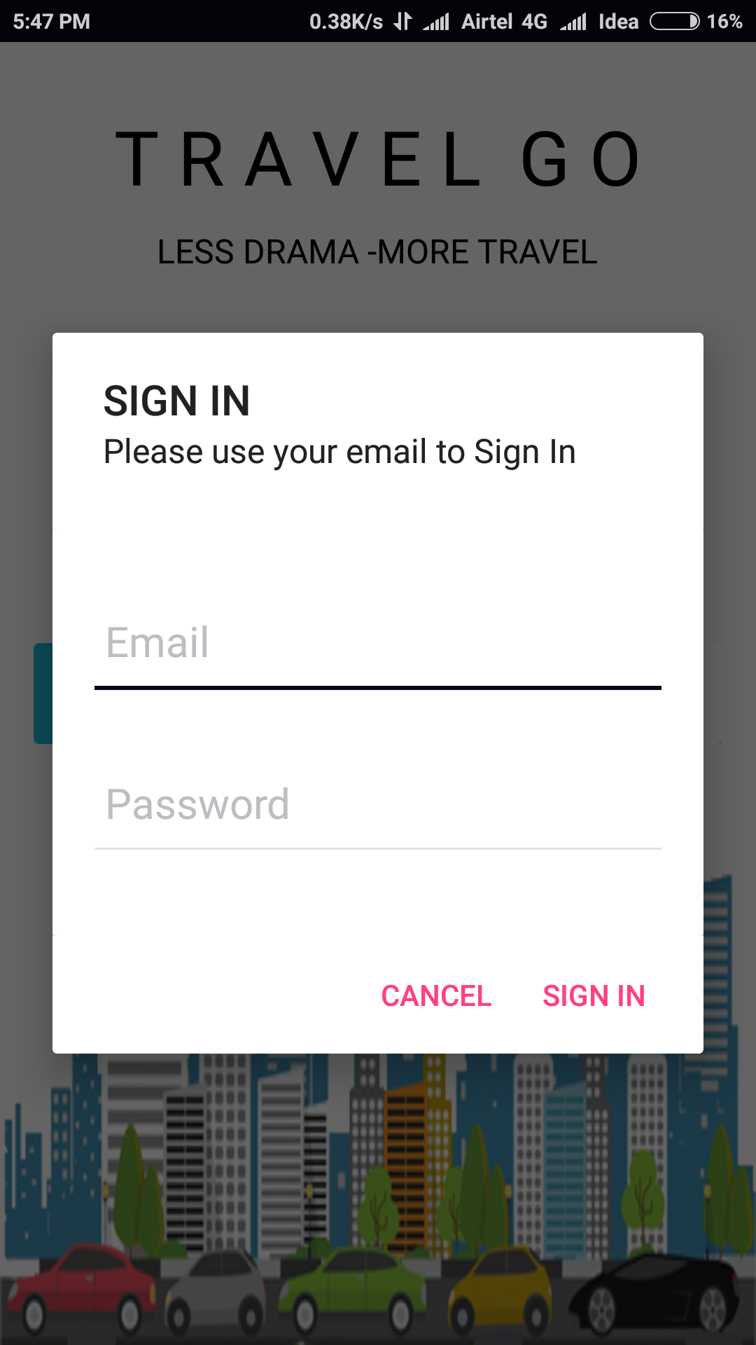
Transport Provider and Passenger Profile Verification and Information Submission

Slide 10
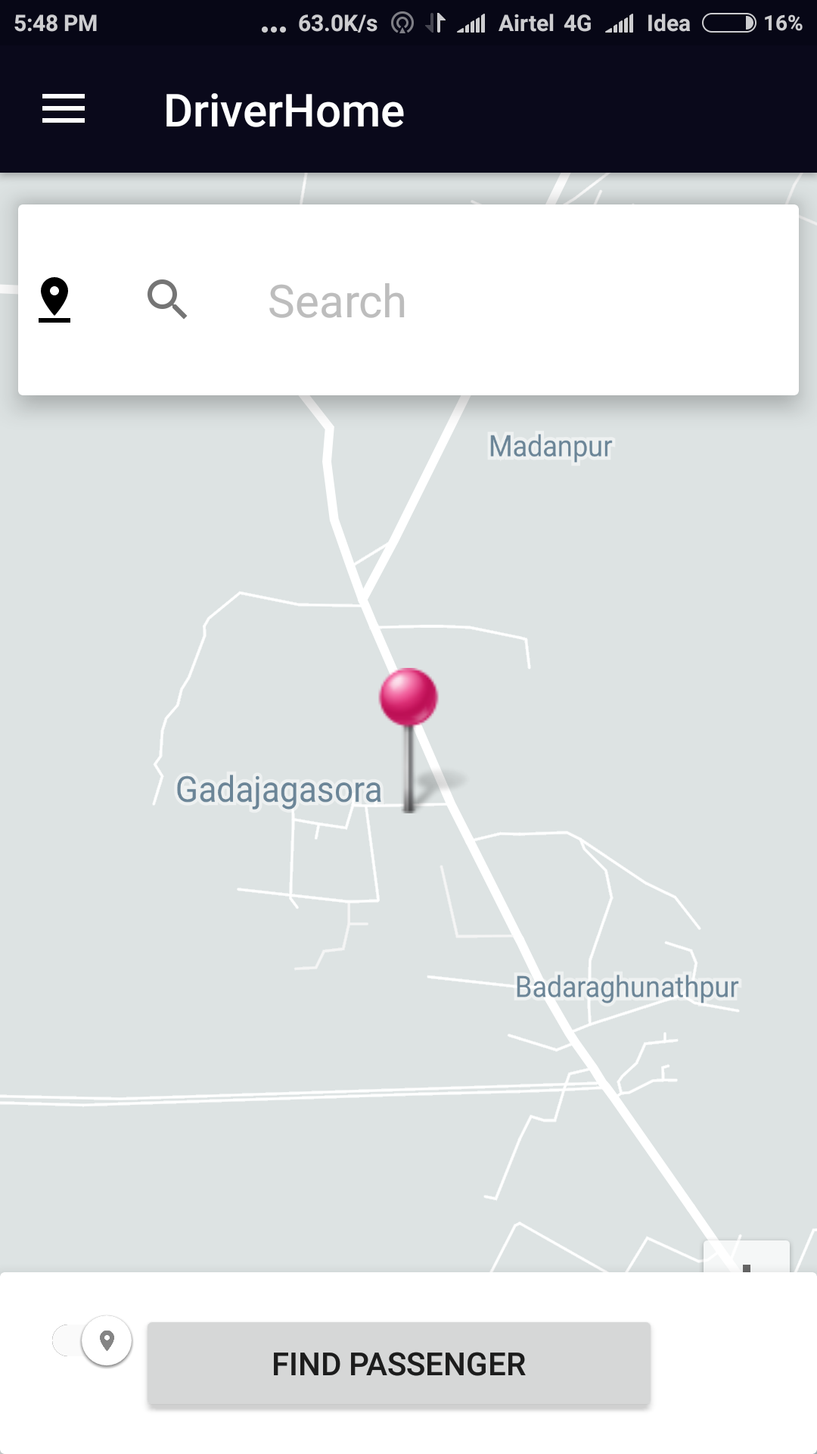
Driver Home
Auto Complete Google Address
Driver Switch Online Or Offline Mode
Find Passenger

Slide 11
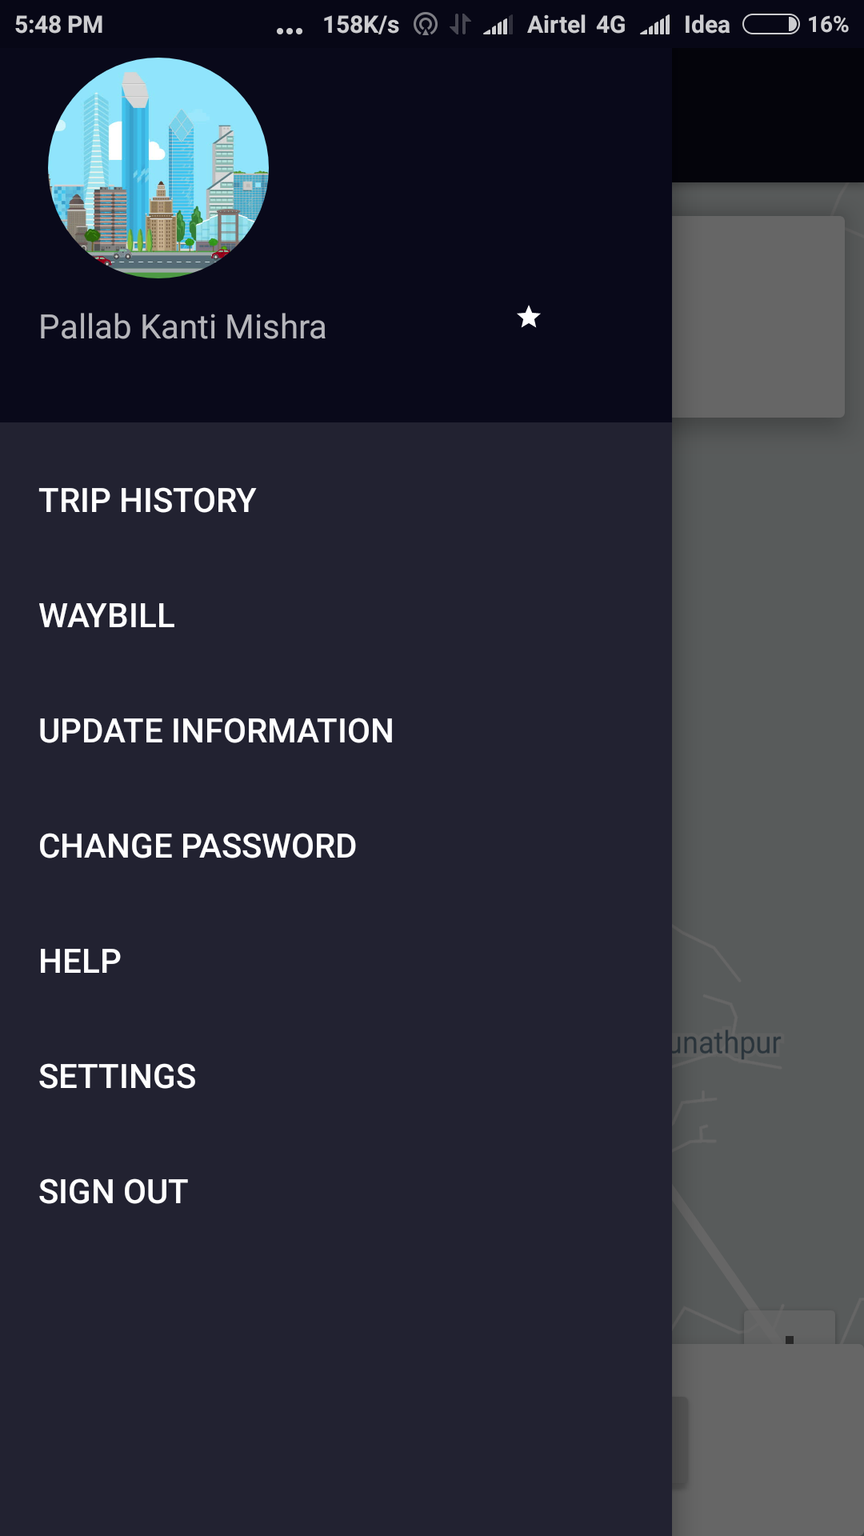
Update Driver Profile Info
Change Password
Trip History
Sign Out

Slide 12
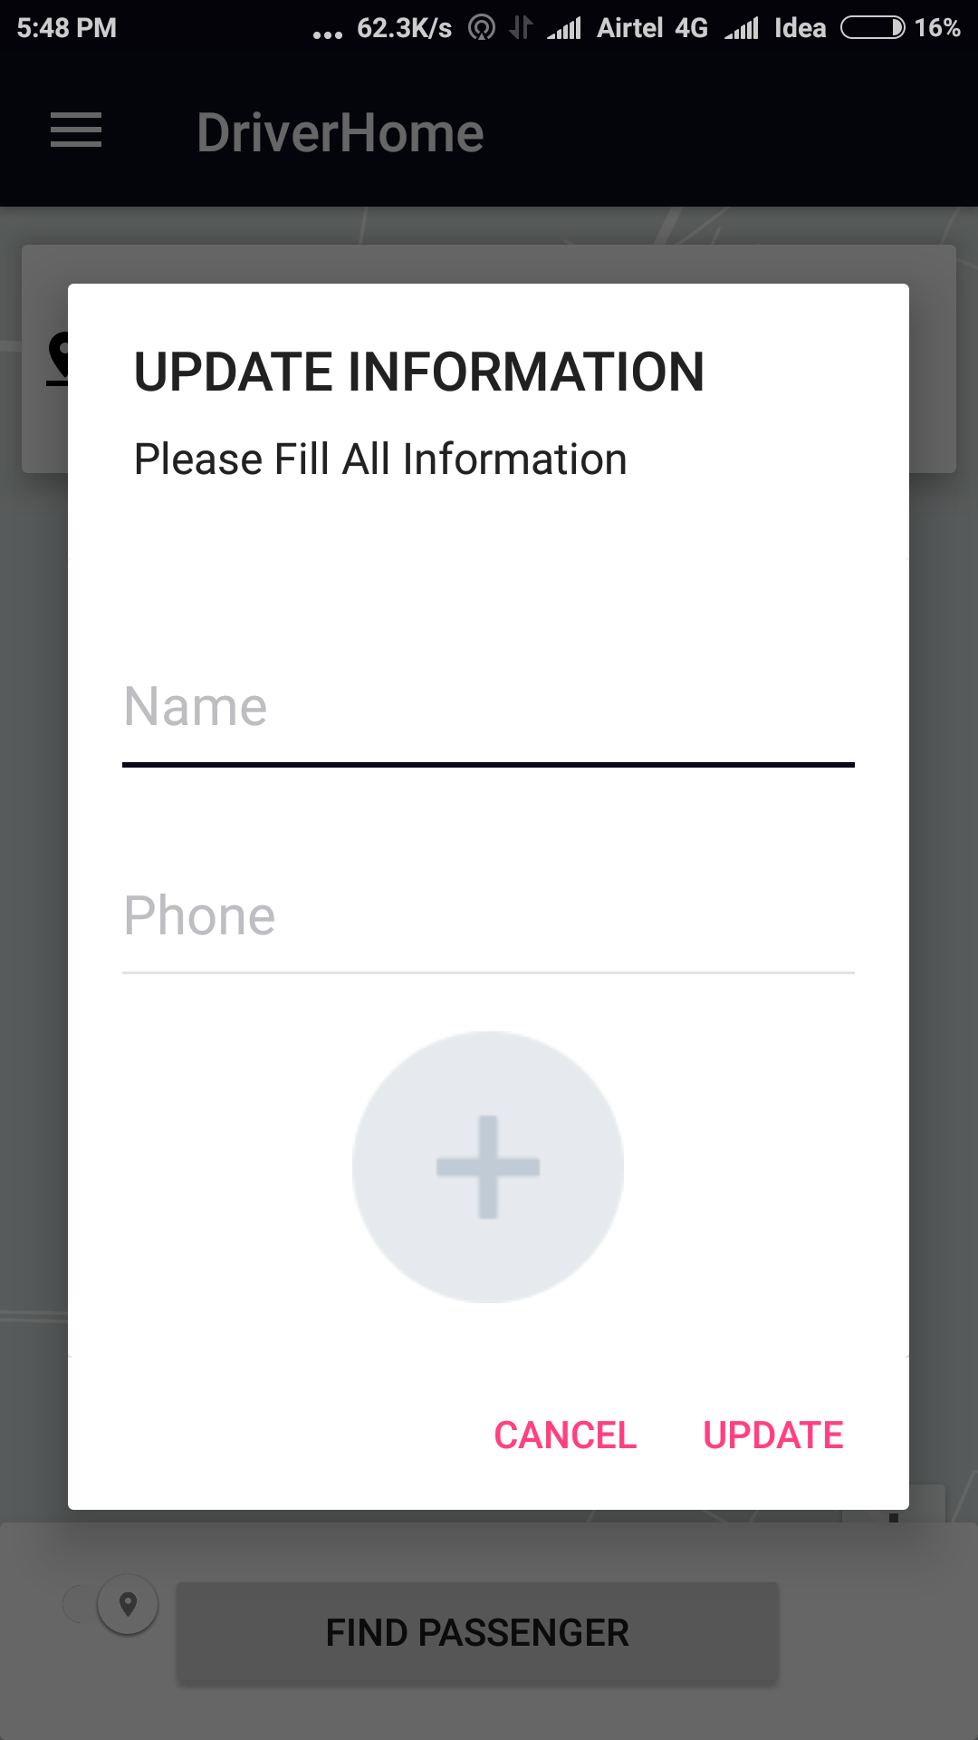
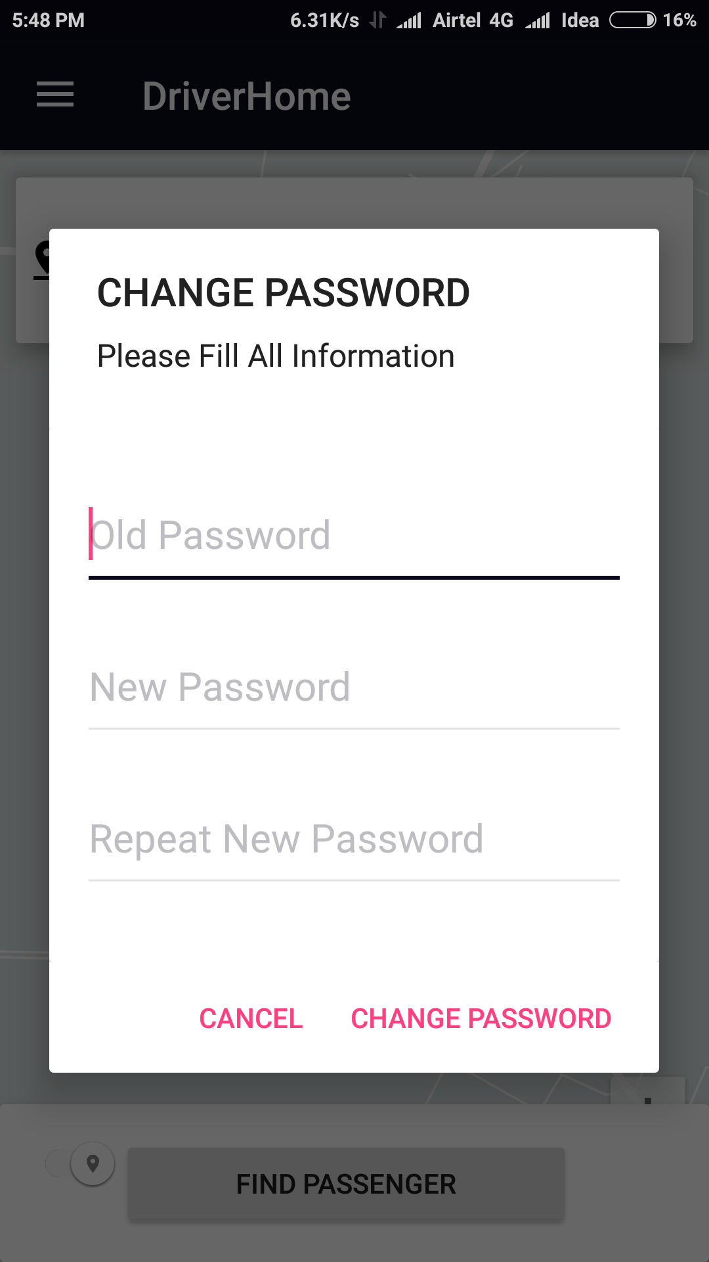
Update Driver Profile Info
Change Password

Slide 13
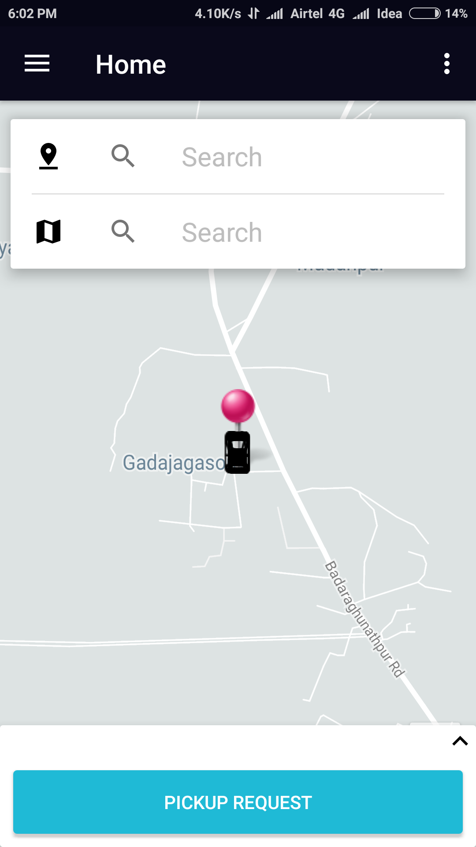
Passenger Home
Pickup/Drop Location Based On Auto Complete Google Address
Pickup Request Button

Slide 14
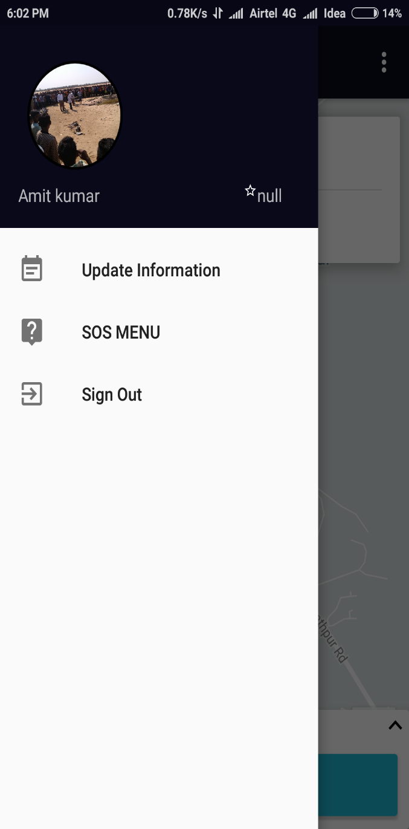
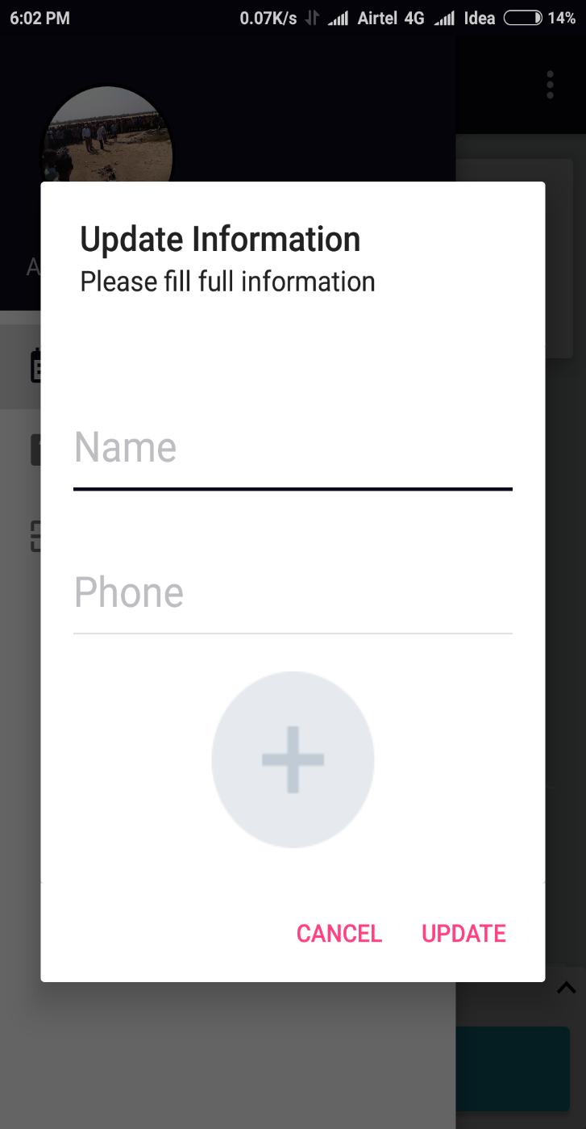
Passenger View And Edit Profile Information
a
SOS/Emergency Contact

Slide 15
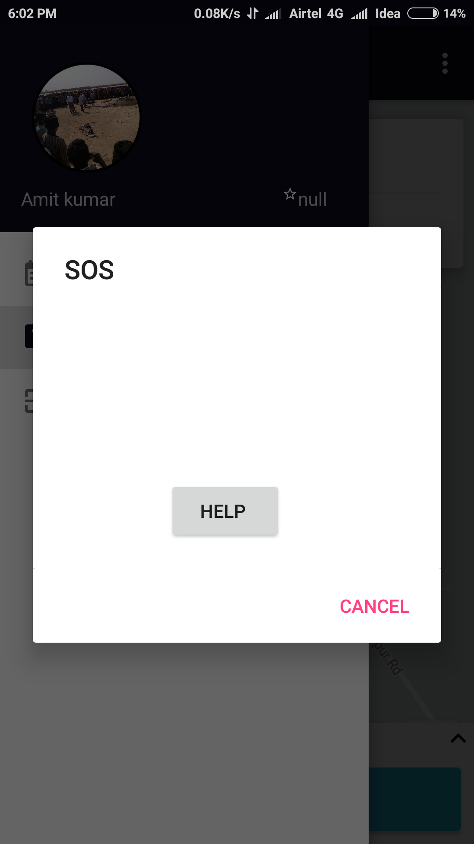
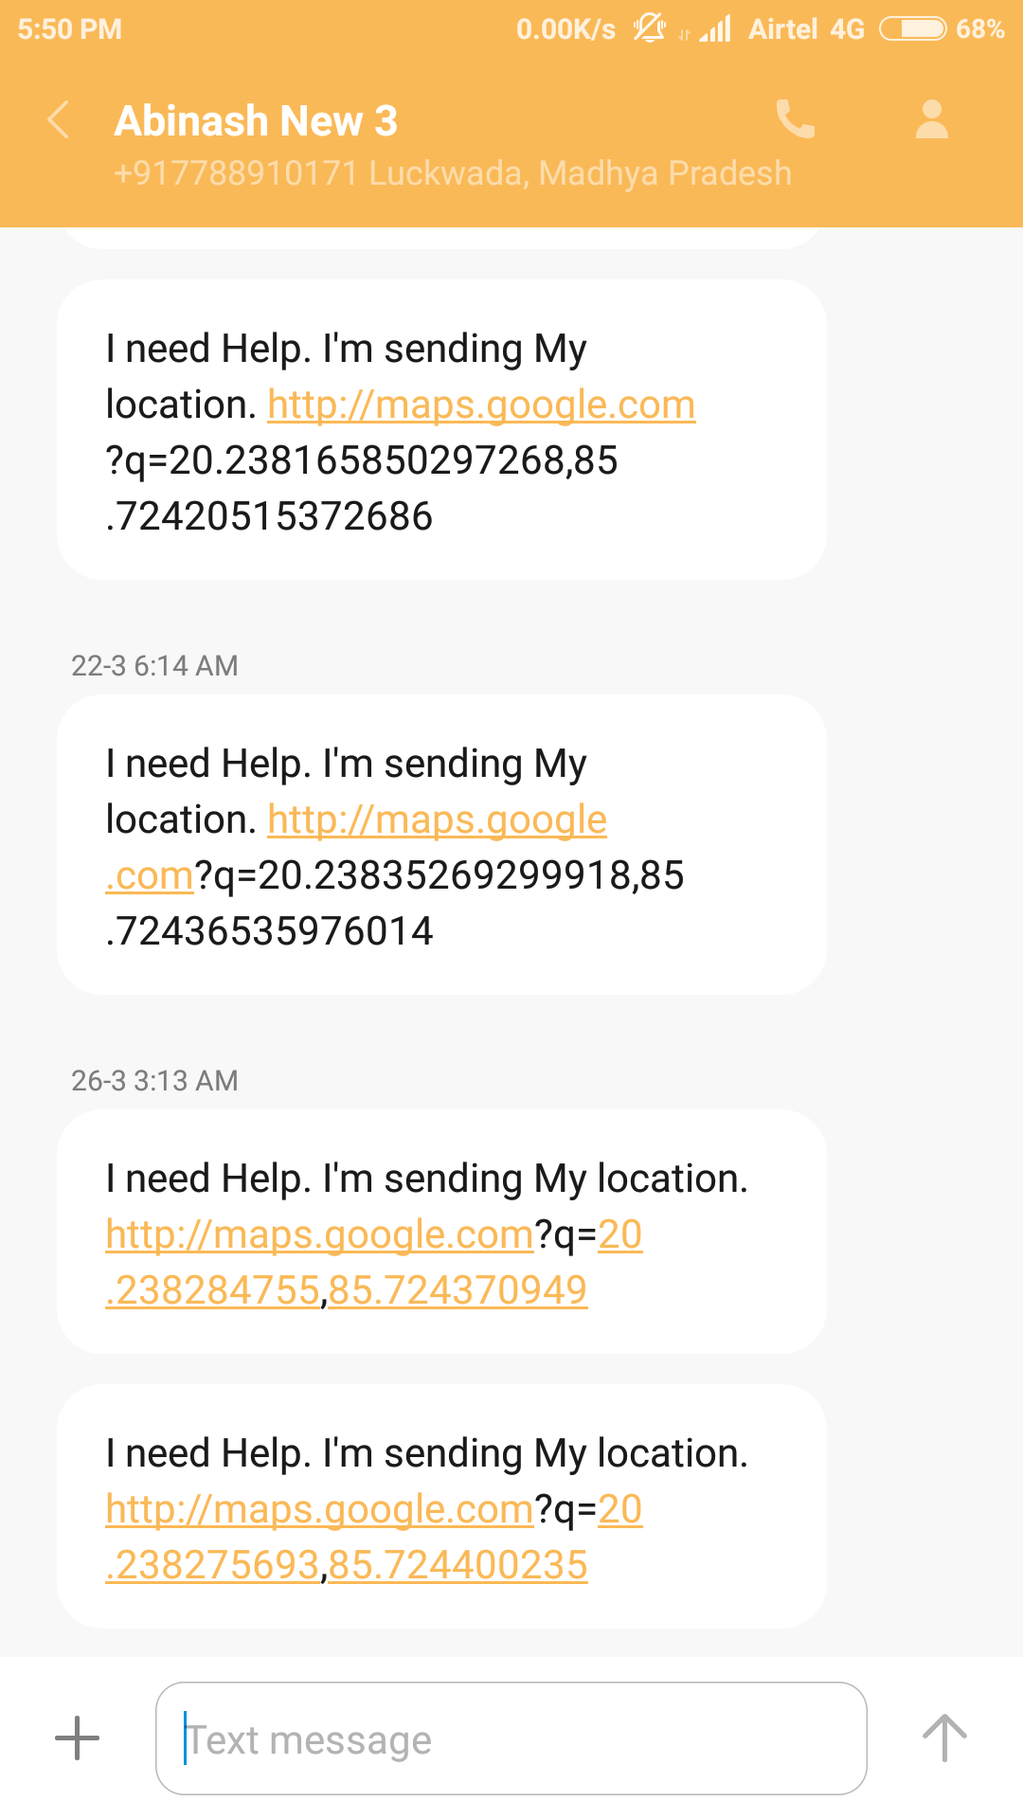
Help Section All The Time

Slide 16
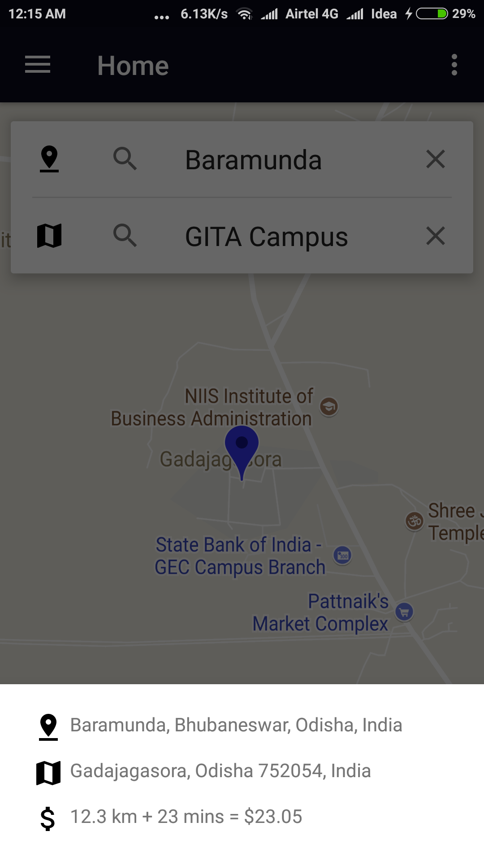
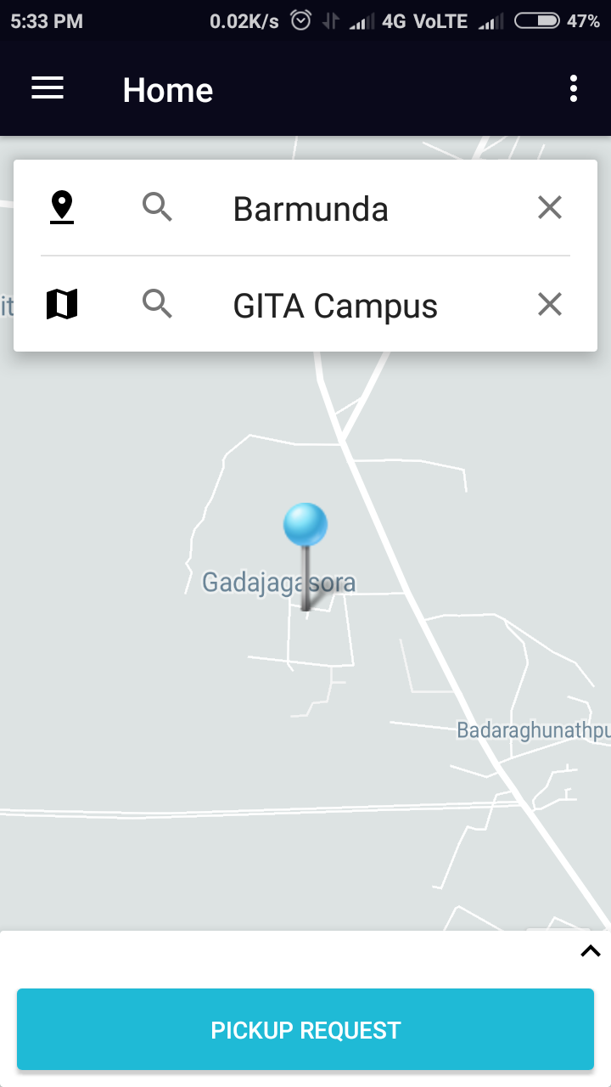
Automatic Fare Calculation Based On Distance
Rate Card Visibility

Slide 17
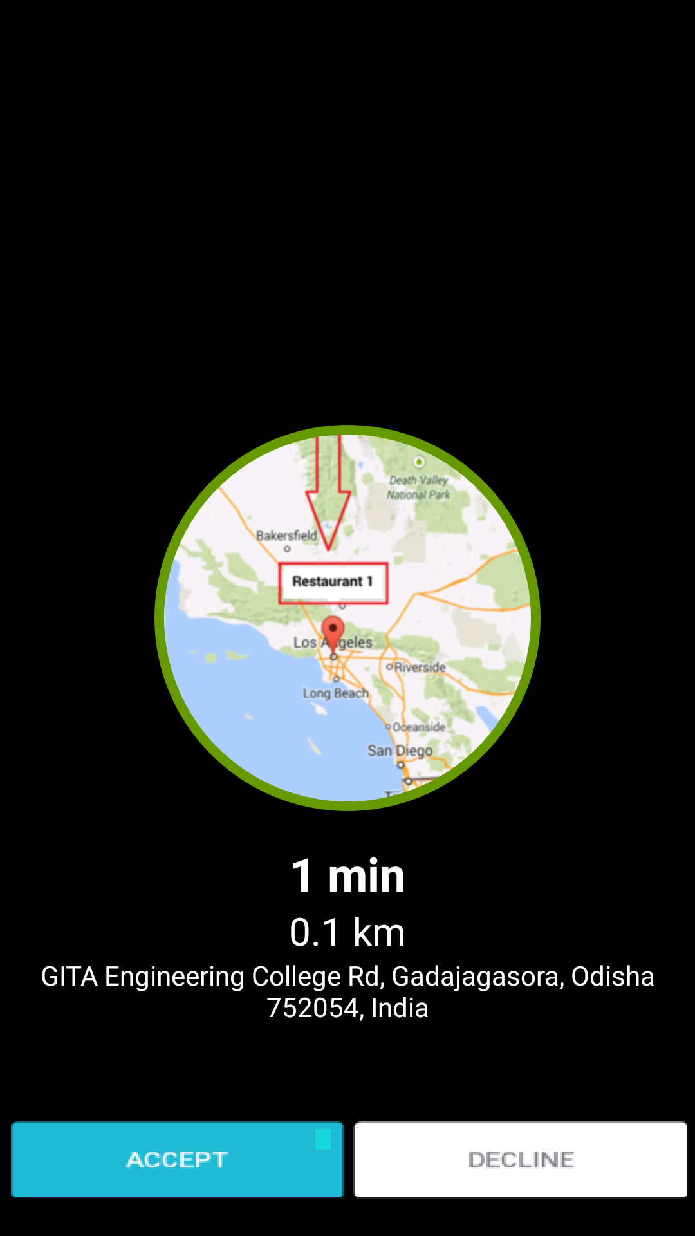
Driver Manages a New Request With The Options Of “Accept” Or “Reject”

Slide 18
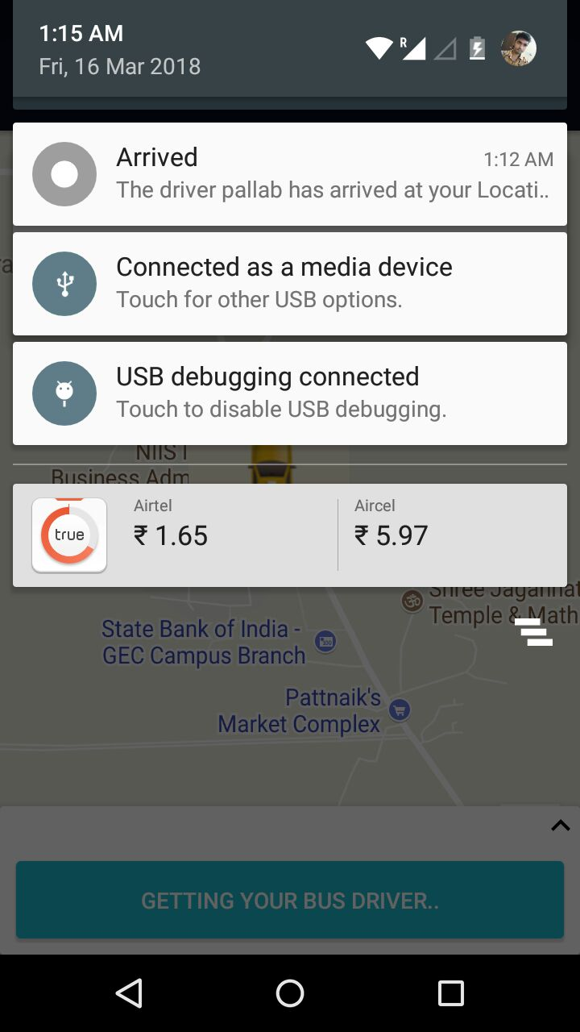
Notification Once The Accepted Driver Has Arrived Can Pick Up The Customer And Earn Money

Slide 19
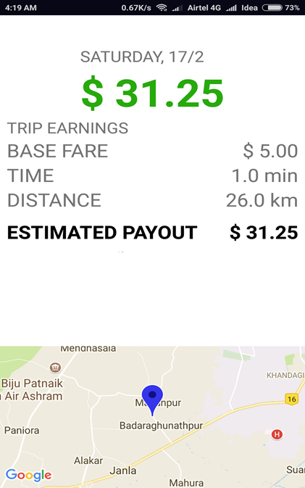
Helps To Know The Approximate Fare For Their Ride

Slide 20
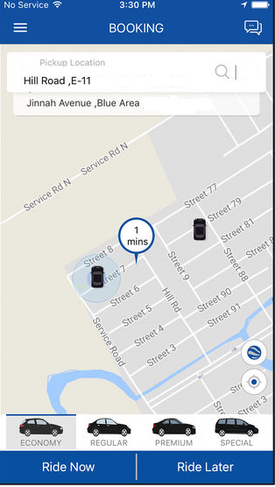

Upcoming Features
Different Available Rides
Users to rate their rides and write reviews

Slide 21
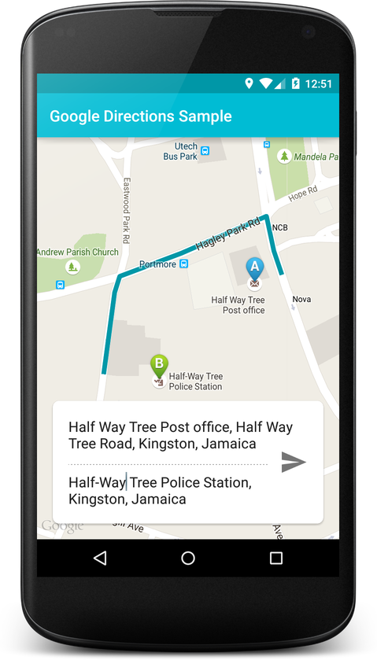
Mobile Application Development Process
Started with problem statement
Submit
Sketch it out
Test & Debug
Add life
Make it look pretty

Slide 22
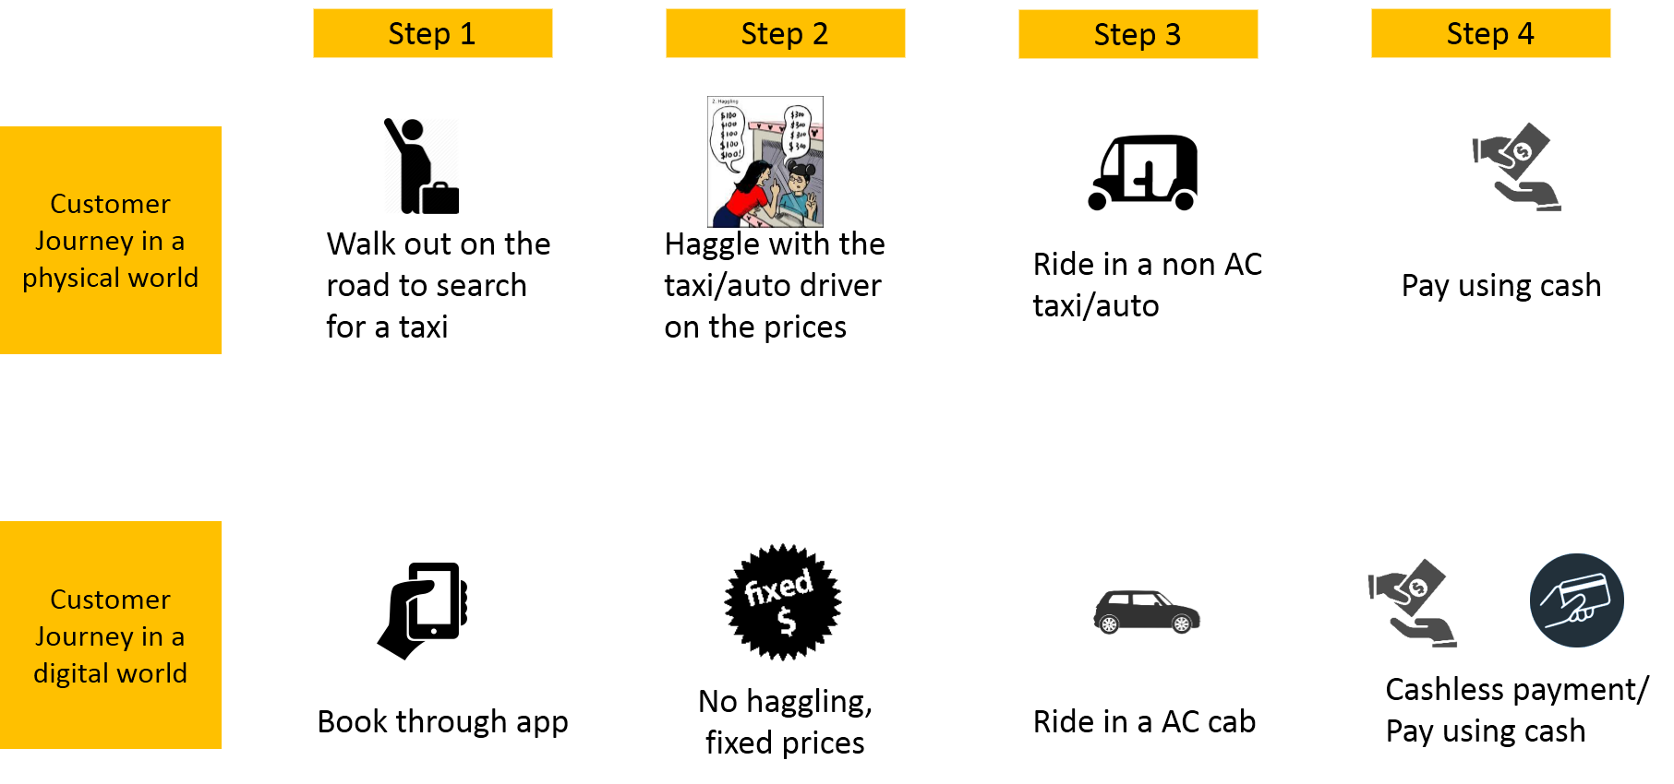
Time To Call TravelGo

Slide 23
THANK YOU!

